Slide 1
CO3 – AT2
INTERACTIVE TREE SIMULATOR
Binary Search Tree – Simulation and Operations
Done By :
Sk. Ashwaq Ahamed

Slide 2
1. Introduction
An interactive tree simulator is a visual tool used to understand tree data structures.
It allows users to create nodes and observe operations step by step.
For this demonstration, a Binary Search Tree (BST) is used.
BST rule: values smaller than a node are placed on the left; larger values are placed on the right.
The simulator makes insertion, searching, deletion and traversal easier to understand.

Slide 3
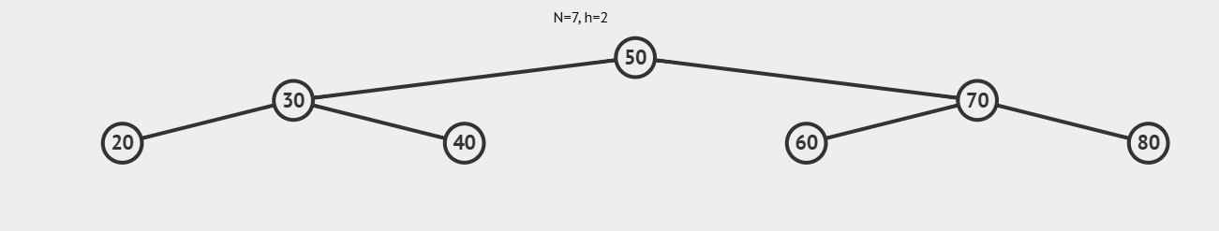
2. Tool Selected – VisuAlgo
Interactive data-structure visualization
Tool: VisuAlgo – Binary Search Tree visualization
Purpose: visually demonstrate how tree operations change the structure.
Main operations used: Create/Insert, Search, Delete and Traversal.
The visual animation helps verify the path followed by each operation.
For the actual submission, add a screenshot of the simulator interface on this slide.

Slide 4
3. Create the Binary Search Tree
Insert the values in this order:
50 → 30 → 70 → 20 → 40 → 60 → 80
After each insertion, observe the position of the new node.
The final tree is balanced for this example and contains seven nodes.
50
30
70
20
40
60
80

Slide 5
4. Insertion Operation
Example: insert 65
Start at the root node 50.
65 > 50, so move to the right subtree.
65 < 70, so move to the left subtree.
65 > 60, so insert 65 as the right child of 60.
The simulator shows this path visually.
50
30
70
65
20
40
60
80

Slide 6
5. Search Operation
Example: search for 60
Begin at 50: 60 is greater, so move right.
At 70: 60 is smaller, so move left.
At 60: the required value is found.
The simulator highlights the nodes visited during the search.
This demonstrates how BST ordering reduces unnecessary comparisons.
50
30
70
20
40
60
80

Slide 7
6. Delete Operation
Example: delete node 20
Node 20 is a leaf node because it has no children.
Select/delete node 20 in the simulator.
The node is removed directly without replacing another node.
Observe the updated tree after deletion.
Deletion can also be demonstrated for a node with one child or two children.
50
30
70
20
40
60
80

Slide 8
7. Tree Traversal
50
30
70
20
40
60
80
Inorder: 20 → 30 → 40 → 50 → 60 → 70 → 80
Preorder: 50 → 30 → 20 → 40 → 70 → 60 → 80
Postorder: 20 → 40 → 30 → 60 → 80 → 70 → 50
Level-order: 50 → 30 → 70 → 20 → 40 → 60 → 80

Slide 9
8. Observations
The simulator gives a clear visual representation of every tree change.
BST insertion follows a comparison-based path from the root.
Searching is efficient when the tree remains reasonably balanced.
Deletion changes the structure while preserving the BST property.
Traversal tools help verify the order of nodes.
Interactive visualization is useful for learning data structures.

Slide 10
9. Advantages of an Interactive Tree Simulator
Easy to understand complex tree operations visually.
Provides immediate feedback after each operation.
Helps students identify parent-child relationships.
Useful for practicing insertion, search, deletion and traversal.
Reduces errors when manually drawing trees.
Supports learning through experimentation.

Slide 11
10. Conclusion
The interactive tree simulator provides a simple way to explore Binary Search Trees.
Insertion, searching, deletion and traversal can be observed step by step.
The simulation improves understanding of tree structure and BST rules.
It is an effective learning aid for data-structure concepts.
The screenshots taken during the live demonstration can be included as evidence.

Slide 12
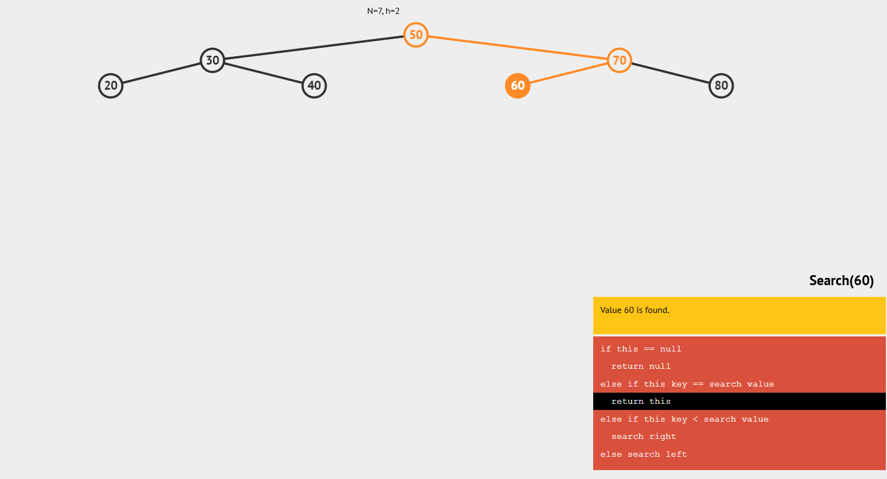
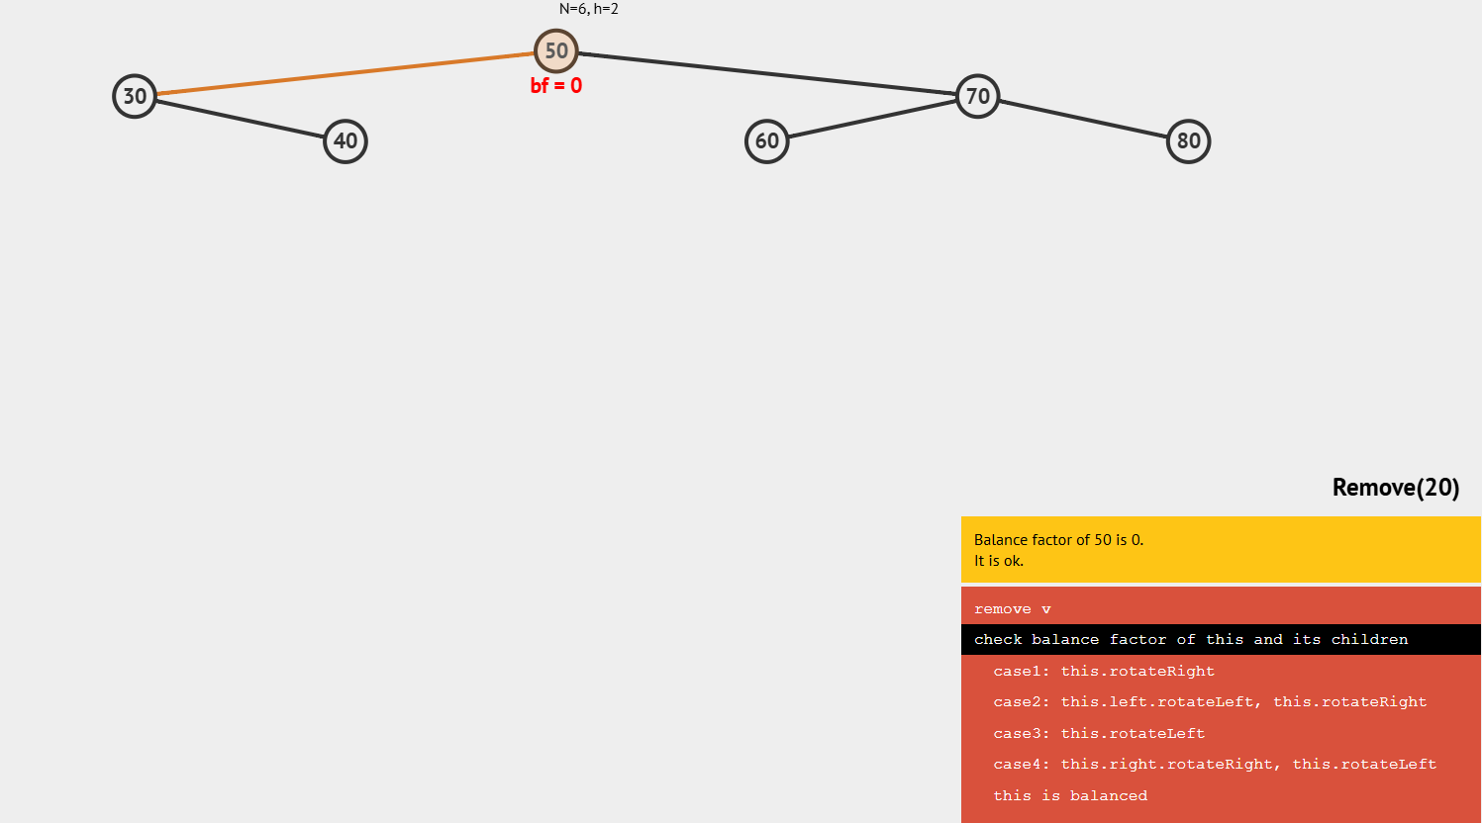
11. Screenshots
Add 3–4 screenshots from the simulator:
1. Initial BST after inserting 50, 30, 70, 20, 40, 60, 80
2. Search operation for 60
3. Delete operation for 20

Slide 13
13. Binary Search Tree Properties
A Binary Search Tree is a hierarchical data structure in which every node can have at most two children.
For each node, values smaller than the node are stored in the left subtree.
Values larger than the node are stored in the right subtree.
The same BST property is maintained after insertion and deletion.
The root node is the starting point for most BST operations.

Slide 14
14. Step-by-Step Working of the Simulator
The simulator begins with an empty tree or an existing set of nodes.
When a value is inserted, it is compared with the current node.
The comparison determines whether the operation moves left or right.
The process continues until the correct position is reached.
For search and deletion, the simulator visually shows the path followed through the tree.
This step-by-step process makes the algorithm easier to observe.

Slide 15
15. Time Complexity of BST Operations
Insertion: O(log n) on a reasonably balanced BST.
Search: O(log n) on a reasonably balanced BST.
Deletion: O(log n) on a reasonably balanced BST.
In the worst case, when the tree becomes highly unbalanced, these operations can take O(n).
Traversal visits every node, so traversal takes O(n).
The simulator helps demonstrate why tree shape affects performance.

Slide 16
16. Types of BST Deletion Cases
Case 1 – Leaf node: a node with no children can be removed directly.
Case 2 – One child: the node is removed and its child takes its position.
Case 3 – Two children: the node is replaced using a suitable successor or predecessor while preserving BST order.
The simulator can be used to observe all three deletion situations.
These cases show how deletion can change the structure of a tree.

Slide 17
17. Practical Applications
Binary Search Trees are useful for maintaining data in an ordered structure.
They can support searching, insertion and deletion operations.
BST concepts are useful in learning searching algorithms and hierarchical data organization.
Tree-based structures are also important as a foundation for more advanced structures such as balanced search trees.
Interactive visualization helps students connect the theoretical algorithm with its actual execution.

Slide 18
18. Learning Outcomes
Understand the basic structure and rules of a Binary Search Tree.
Perform insertion by following comparisons from the root.
Understand how search follows a path through the tree.
Identify the different cases involved in deletion.
Perform and verify tree traversals.
Observe how the shape of a tree can influence operation efficiency.
Use an interactive simulator as a practical learning tool.

Slide 19
19. Extended Observation
The selected example contains seven initial nodes arranged according to BST rules.
Adding 65 demonstrates insertion into an existing subtree.
Searching for 60 demonstrates how comparisons eliminate unnecessary branches.
Deleting 20 demonstrates the simplest deletion case because it is a leaf.
Traversal results provide another way to verify that the tree contains the expected values.
The visual simulator makes these changes easier to follow than a static diagram.

